Slide 1

LIBRARY MANAGEMENT SYSTEM (L.M.S)
Submitted by:
Tanmay Arora, Vishvajeet Sharma

Slide 2
l.m.s. INTRODUCTION
A Library management system(L.M.S) or an Automated
library system is a software that has been developed
to handle basic housekeeping functions of a library.
It’s a well organized software solution for a library.
It helps to provide information of any book
present in the library or issued to the student.
It keeps a track of books issued, returned and
added to library.

Slide 3
SCOPE OF PROJECT:
To make the existing system more efficient.
To provide a user friendly environment where user can be serviced better.
Make functioning of library faster.
Provide a system where the library staff can
catch defaulters and not let them escape.
To minimize the loss done to books.

Slide 4
tools used in Library Management java project :
This is an Application used by librarians to handle necessary operations in a library.
Technologies and Products used:
NetBeans 8.2 IDE
MySQL DataBase Server 5.1
JDBC Driver :- mysql-connector-java jar file
Java Development Kit (JDK)
Java Runtime Environment (JRE)

Slide 5
specifications
1.HARDWARE SPECIFICATIONS:-
PROCESSOR : Intel core i3 3rd generation
MEMORY : 2 GB RAM
HARD DISK : 512GB
2.SOFTWARE SPECIFICATIONS:-
USER INTERFACE : NetBeans IDE 8.2
DATABASE : MySQL Server 5.1
PLATFORM : WINDOWS XP/7/8/9/10

Slide 6
MODULES
HOME PAGE MENU
ADD NEW BOOKS
BOOK DETAILS
STUDENT REGISTRATION
ISSUE BOOK
ISSUED BOOK DETAILS
RETURN BOOK

Slide 7
DATA BASE DESIGN

Slide 8
TABLE NAME: BOOKS
FIELD NAME | TYPE OF DATA
Book_id | Number
Book_name | Text
Author | Text
Stream | Text
Class | Text
TABLE NAME: student
FIELD NAME | TYPE OF DATA
Student_id | Number
Student_name | Text
Stream | Text
Class | Text
Address | Text

Slide 9
TABLE NAME: issue_book
FIELD NAME | TYPE OF DATA
Student_id | Number
Student_name | Text
Book_id | Number
Book_name | Text
Address | Text
Issue_date | Date
Stream | Text
Class | Text

Slide 10
TABLE NAME: return_book
FIELD NAME | TYPE OF DATA
Student_id | Number
Student_name | Text
Book_id | Number
Book_name | Text
Issue_date | Date
Return_date | Date

Slide 11
Screen shots

Slide 12
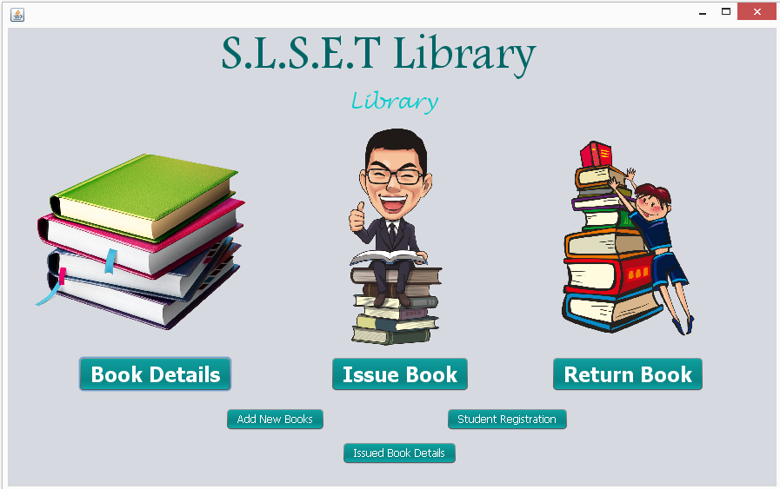
Fig 1.1- Welcome page of LMS

Slide 13
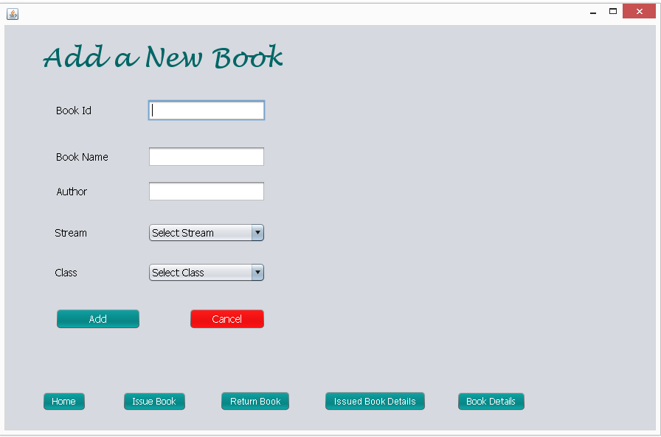
Fig 1.2- Add a new book

Slide 14
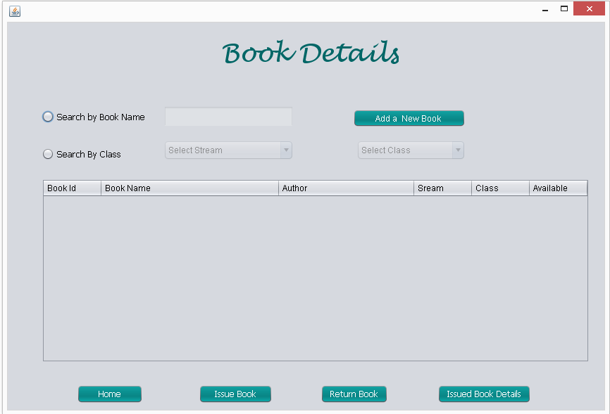
Fig 1.3- book details

Slide 15
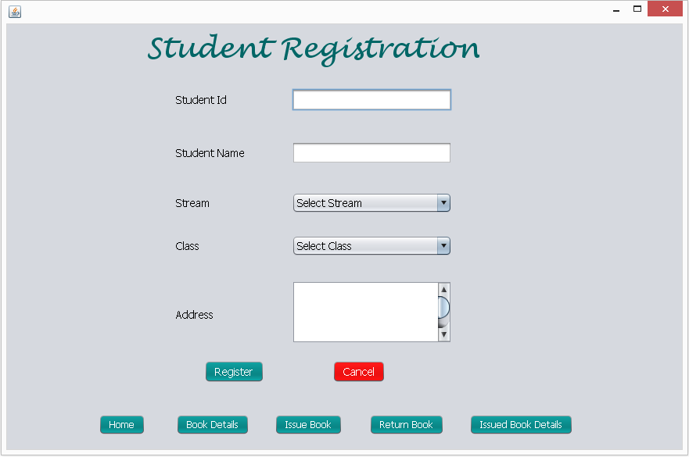
fig1.4 student Registration

Slide 16
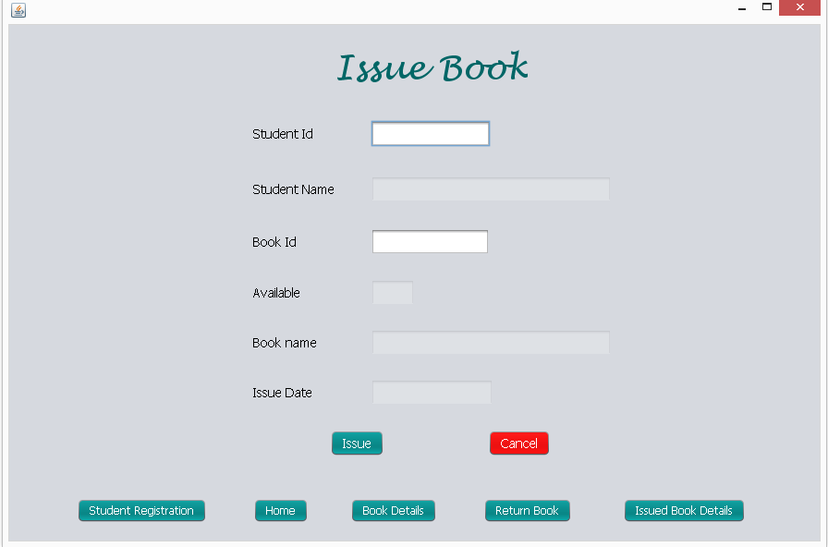
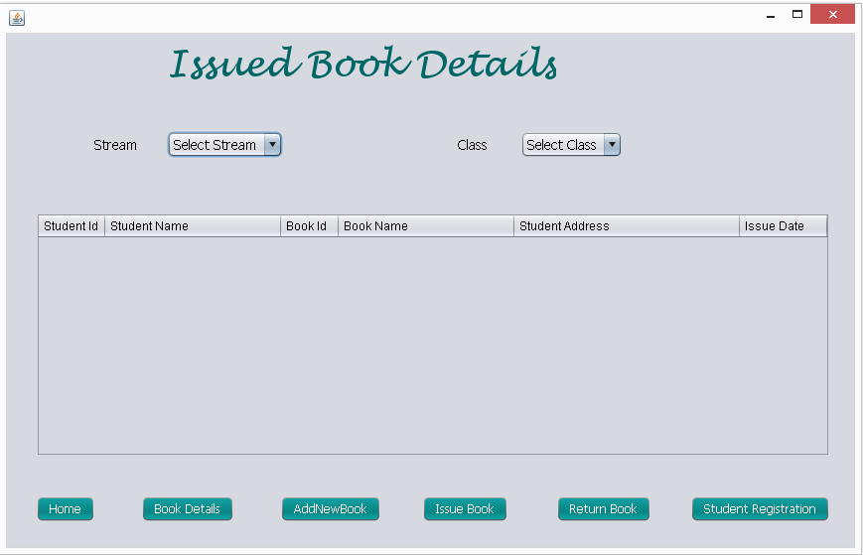
fig 1.5 issue book
Fig 4.5- Issue Book
Fig 4.6- Issued book details

Slide 17
Fig 1.6- Issued book details

Slide 18
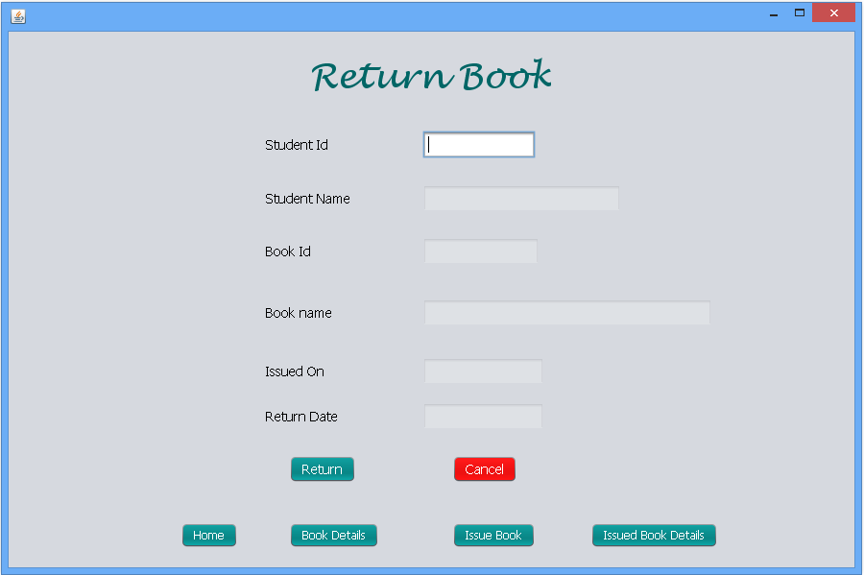
fig 1.5 return book

Slide 19
FUTURE SCOPE
To make Software Platform -Independent.
To make the Software general accessibility to the users.
Giving inner topics highlights of the book searched.
To make the System Online for Cloud Storage.
Providing space for online suggestions.
To add more features and graphics making it User-Friendly.

Slide 20
CONCLUSION
The system has been developed using NetBeans IDE and MySQL DataBase Server. The system was able to process and update the database with more ease.
It helped in developing a total integrated system.
Thus the project titled –
“LIBRARY MANAGEMENT SYSTEM” can be altered in accordance with the future requirements of the organization.

Slide 21


